Slide 1
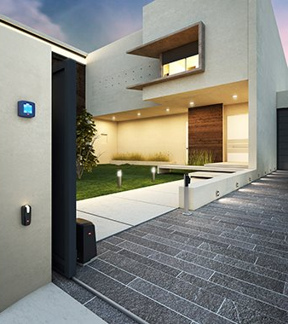
ARES ULTRA BT B
ARES BT B
GUIDE TO CHOOSING

Slide 2
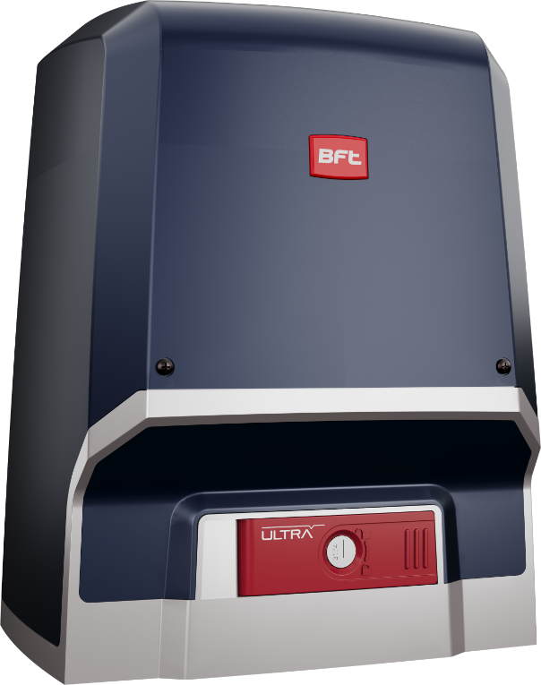
ARES ULTRA BT B
ARES BT B
VALUE PROPOSITION: ​New Ares is engineered to streamline sliding gate automation installation in single & multi-residential and commercial buildings, offering faster setup with improved speed and security. Utilizing EasyAxs tools, it ensures efficient installation and remote configuration. The system also optimizes energy usage to meet European standards, promoting a minimal environmental footprint through reduced power consumption.​
SMART FEATURES – new connected solutions for installers and end users, thanks to U-Link 2.0 and U-Security ​
FAST MANEUVERING – new Ares Ultra BT B and Ares BT B increase gate maneuvering speed by 30%

Slide 3
PHASE IN ARES ULTRA BT B
NEW REFERENCES
BFT ID REF.​ | MDM REF.​ | OLD MODEL​ | SUBSTITUTION TYPE​ | NEW BFT ID REF.​ | NEW MDM REF.​ | NEW MODEL​
P926193 00002 | 2600857 | ARES ULTRA BT A 1000 | REPLACED BY | P926203 00002 | 2618284 | ARES ULTRA BT B1000
P926191 00002 | 2600502 | ARES ULTRA BT A 1500 | REPLACED BY | P926204 00002 | 2618287 | ARES ULTRA BT B1500
R925295 00001 | 2611842 | ARES ULTRA BT KIT A 1000 FRA | REPLACED BY | R925399 00002 | 2618286 | ARES ULTRA BT KIT B1000 INT

Slide 4
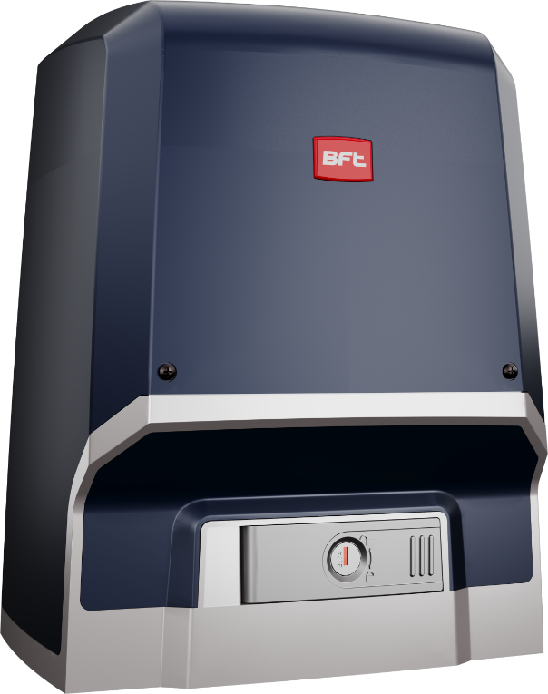
PHASE IN ARES BT B
NEW REFERENCES

