Slide 1
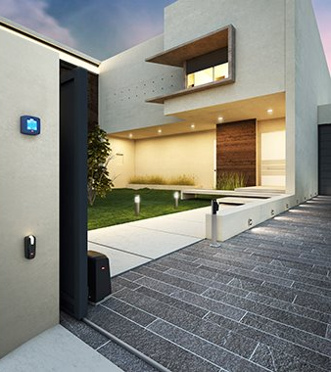
DEIMOS ULTRA BT B
GUIDE TO CHOOSING

Slide 2
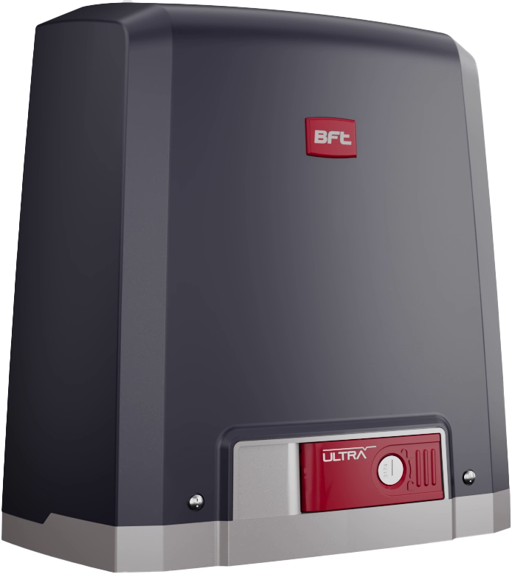
DEIMOS ULTRA BT B
VALUE PROPOSITION: Tailored to streamline the installation process of sliding gate automation, new Deimos’ higher speed also improves convenience and security for the end user. Smart operator ready for the installer’s new EasyAxs tools and the end user's smart home systems. Plus, new Deimos sets the standard for energy efficiency, aligning with the latest European Regulation, boasting minimal power consumption in standby mode.​
SMART FEATURES – new connected solutions for installers and end users, thanks to U-Link 2.0 and U-Security
FAST MANEUVERING – new Deimos Ultra BT B and Deimos BT B increase gate maneuvering speed by 20%

Slide 3
PHASE IN DEIMOS ULTRA BT – New references
BFT ID REF.​ | MDM REF.​ | OLD MODEL​ | SUBSTITUTION TYPE​ | NEW BFT ID REF.​ | NEW MDM REF.​ | NEW MODEL​
P925221 00002​ | 2611580​ | DEIMOS ULTRA BT A400​ | REPLACED BY​ | P925269 00002​ | 2618198​ | DEIMOS ULTRA BT B400​
P925223 00002​ | 2600852​ | DEIMOS ULTRA BT A600​ | REPLACED BY​ | P925268 00002​ | 2618199​ | DEIMOS ULTRA BT B600​
R925265 00002​ | 2611817​ | DEIMOS ULTRA BT KIT A400 FRA​ | REPLACED BY​ | R925367 00002​ | 2618202​ | DEIMOS ULTRA BT KIT B400 INT​
R925290 00002​ | 2611837​ | DEIMOS ULTRA BT A400 KIT PL​ | REPLACED BY​ | R925371 00002​ | 2618207​ | DEIMOS ULTRA BT KIT B400 EE​
R925269 00002​ | 2600881​ | DEIMOS ULTRA BT KIT A600 FRA​ | REPLACED BY​ | R925372 00002​ | 2618211​ | DEIMOS ULTRA BT KIT B600 INT​
R925292 00002​ | 2611839​ | DEIMOS ULTRA BT A600 KIT PL​ | REPLACED BY​ | R925375 00002​ | 2618214​ | DEIMOS ULTRA BT KIT B600 EE​
​ | ​ | ​ | NEW OFFER​ | R925372 00005​ | 2618450​ | DEIMOS ULTRA BT KIT B600 EASYAXS INT​

