Slide 1

Ilmo2 WT
Phase out information

Slide 2
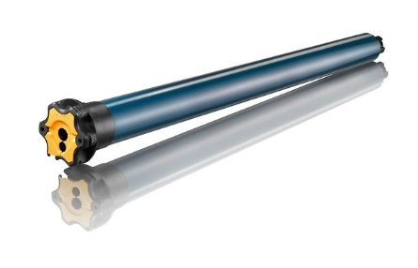







Comparison
Launched at beginning of 2025
Phase out at the end of 2025
Ilmo 2 50 WT
Ilmo 3 50 WT
Voltage: 230V
End-limit: electronical
Torque: 6-20 Nm
Speed: 17 rpm
Obstacle detection: Yes
Settings: P& P, automatic only
+ intelligent end limit back release
+ silent movement
Voltage: 230V
End-limit: electronical
Torque: 6-20 Nm
Speed: 17 rpm
Obstacle detection: Yes
Settings: P& P, automatic only
+ intelligent end limit back release
Back release
Tamper
resistance
Obstacle
detection
Protection against freezing
Somfy
drive control
Protection against freezing
Somfy
drive control
Silent
movement
Back release
Tamper
resistance
Obstacle
detection

Slide 3
Ilmo2 WT phase out – matrix - MOTORS
Ilmo 2 references
Ilmo 3 references
Ref | Description | Ref | Description
1130485 | ILMO2 50WT 6/17 VVF3M BAR | 1246353 | ILMO3 50WT 6/17 VVF3M BAR
1130492 | ILMO2 50WT 10/17 VVF3M BAR | 1246383 | ILMO3 50WT 10/17 VVF3M BAR
1131261 | ILMO2 50WT 15/17 VVF3M BAR | 1246354 | ILMO3 50WT 15/17 VVF3M BAR
1132191 | ILMO2 50WT 20/17 VVF3M BAR | 1246386 | ILMO3 50WT 20/17 VVF3M BAR
Ilmo 3 P100 references*
1246992 | ILMO3 50 WT 10/17 VVF 3M P100 + VVF CABLE OCTO 50
1246990 | ILMO3 50 WT 6/17 VVF 3M P100 + VVF CABLE OCTO 50
*creation in progress – dedicated to Eko-Okna

