Slide 1

J4 io → J4S io
Phase out information

Slide 2






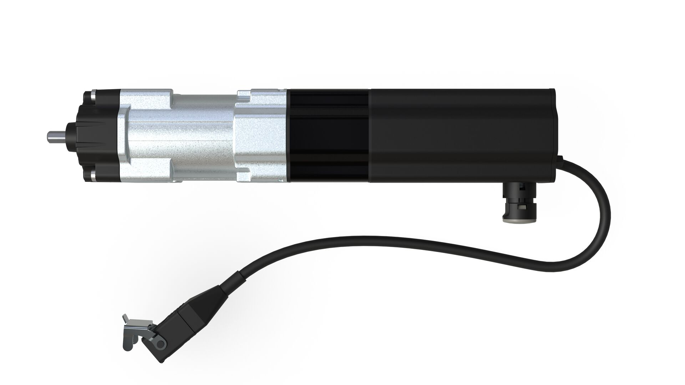
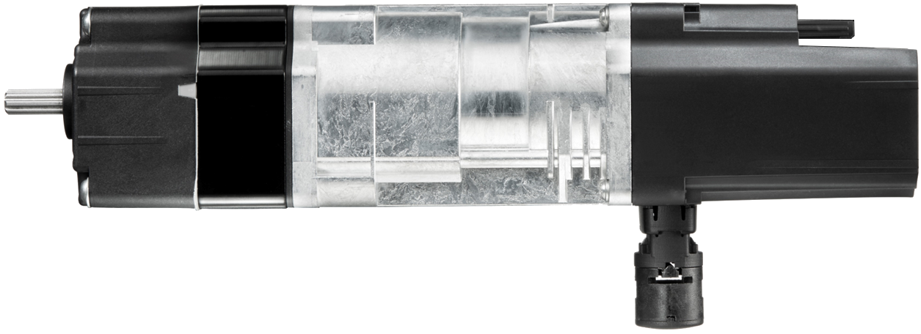


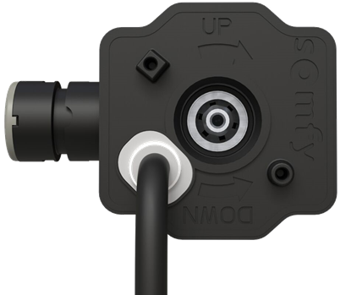
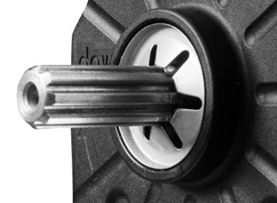
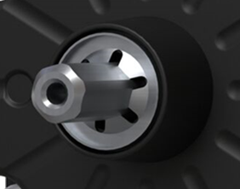
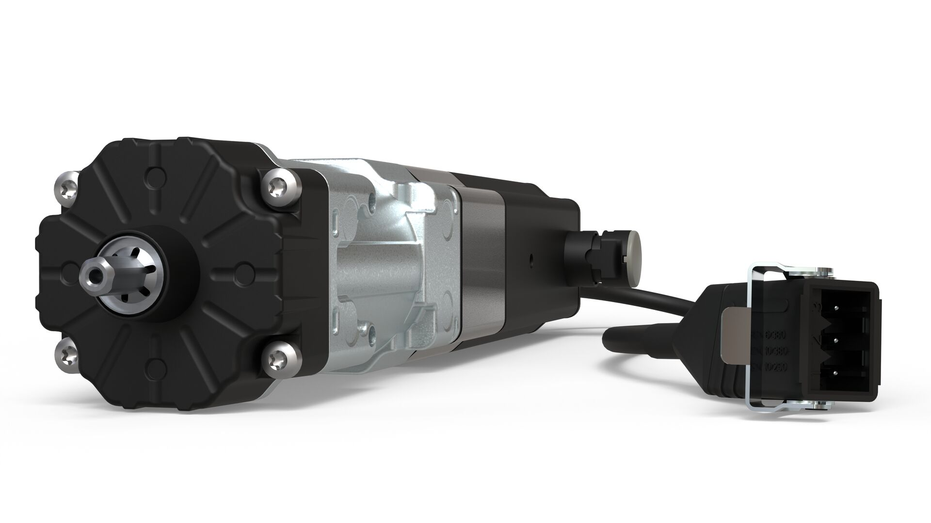
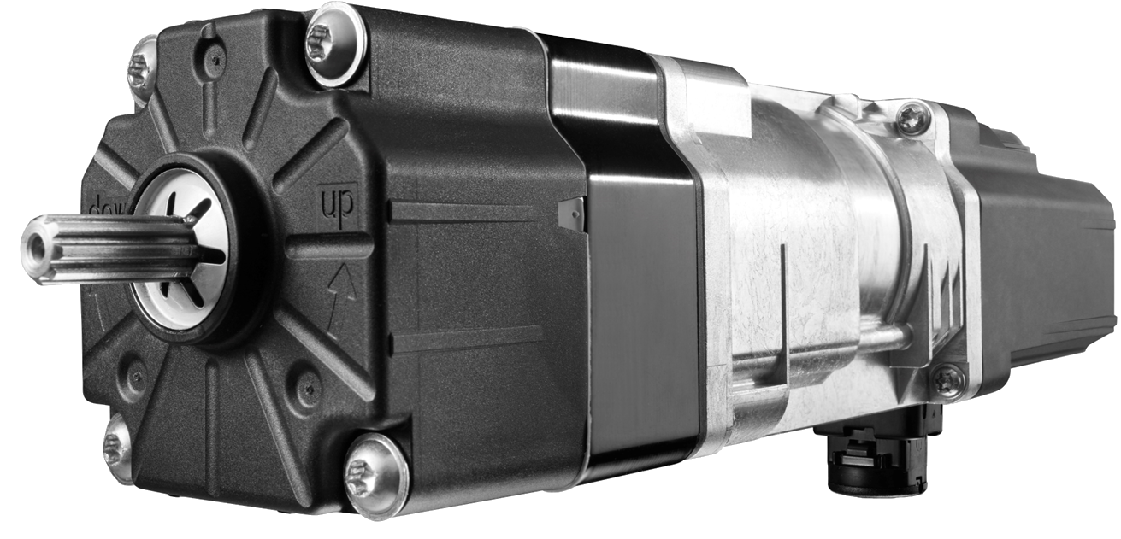

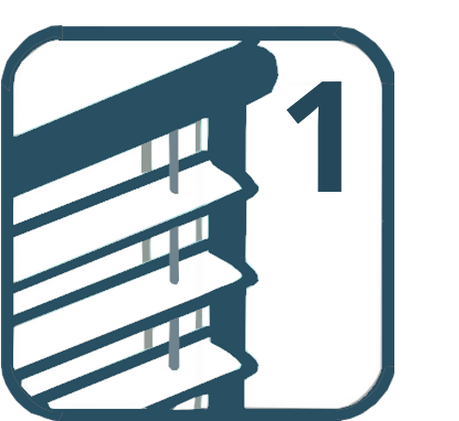


Comparison
J4 io protect
J4 S io protect with silent movement
Obstacle detection
Frost detection
Back release
up readjustment
Favorite position
Obstacle detection
Frost detection
Back release
up readjustment
Favorite position
Silent function
Power Supply: 230V - 50Hz
Motor output speed: 24 RPM
Range: 6Nm, 10Nm & 18Nm
Removable cable 0,5m or 0,9m
Power Supply: 230V - 50Hz
Motor output speed: 24 RPM
Range: 6Nm & 10Nm
Unremovable cable 0,5m or 0,9m
Notes:
18Nm never sold – Quantity?

Slide 3
J4 io protect phase out – matrix - MOTORS
NEW REF | DESCRIPTION | OLD REF | DESCRIPTION
1244795 | J4S 6 IO PRO 0,5M GEN2 UNI | 1210676 | J4 6/24 IO PRO UNIT SW/CZ-P89
1244796 | J4S 6 IO PRO 0,5M GEN3 UNI | 1210679 | J4 6/24 IO PRO UNIT AUST-P89
1244797 | J4S 6 IO PRO 0,9M ROM 144 | 1210682 | J4 6/24 IO PR P144 RO/DIF-P62
1244800 | J4S 6 IO PRO 0,5M ISO 144 | 1210686 | J4 6/24 IO PRO PACK AUST-P89
1244803 | J4S 6 IO PRO 0,5M STE 144 | 1210708 | J4 6/24 IO PRO PACK W/H-P39
1244804 | J4S 6 IO PRO 0,5M HD UNI | 1210725 | J4 6/24 IO PRO UNIT RO/DI-P62
1244805 | J4S 6 IO PRO 0,5M STE UNI | 1210726 | J4 6/24 IO PRO UNIT W/H - P39
1244806 | J4S 6 IO PRO 0,5M HEL 144 | 1240210 | J4 06/24 IO PRO PACK HE-P39
1244808 | J4S 6 IO PRO 0,5M GEN1 144 | 1241006 | J4 6/24 IO PRO PACK SWCZ-P89
1244809 | J4S 6 IO PRO 0,5M HD 144 | 1241349 | J406 IO+ 6/24 0.5M HD PACK-P39
1244810 | J4S 10 IO PRO 0,5M GEN2 UNI | 1210677 | J4 10/24 IO PRO UNI SW/CZ-P89
1244811 | J4S 10 IO PRO 0,5M GEN3 UNI | 1210680 | J4 10/24 IO PRO UNIT AUST-P89
1244812 | J4S 10 IO PRO 0,9M ROM UNI | 1210683 | J4 10/24 IO PR UNIT RO/DIF-P62
1244814 | J4S 10 IO PRO 0,5M STE UNI | 1210709 | J4 10/24 IO PRO UNIT W/H-P39
1244816 | J4S 10 IO PRO 0,5M HEL UNI | 1240211 | J410 10/24 IO PRO UNIT HE-P39
1244818 | J4S 10 IO PRO 0,5M HD UNI | 1241350 | J410 IO+10/24 0.5M HD UNIT-P39
1244819 | J4S 6 IO PRO 0,5M GEN1 UNI | 1210673 | J406 6/24 IO PROTECT UNIT-P145
1244820 | J4S 10 IO PRO 0,5M GEN1 UNI | 1210674 | J4 10/24 IO PROTECT UNIT-P145
1245829 | J4S 6 IO PRO 0,5M NYF 144 | 1241342 | J406 IO+ 6/24 0.5M AA PACK-P89
1245830 | J4S 6 IO PRO 0,5M NYF UNI | 1241343 | J406 IO+ 6/24 0.5M AAUNIT-P89
1245831 | J4S 10 IO PRO 0,5M NYF UNI | 1241344 | J410 IO+ 10/24 0.5M AAUNIT-P89
1246051 | J4S 6 IO PRO 0,5M SCHL 144 | 1245840 | J406 6/24 IO PRO 0,5M SCHL-P98
1246065 | J4S 6 IO PRO 0,5M GEN2 144 | 1246061 | J406 IO PRO 0,5M GEN2 144-P98
1246066 | J4S 10 IO PRO 0,5M GEN4 UNI | 1246062 | J410 IO PRO 0,5M GEN4 UNIT-P98
1246722 | J4S 6 IO PRO 0,5 CLI BB | 1246295 | J4/06 IO PRO 0,5 CLI BB-P89
1246842 | J4S 6 IO PRO 0,5M GEN3 144 | 1241006 | J4 6/24 IO PRO PACK SWCZ-P89
1246843 | J4S 10 IO PRO 0,5M GEN5 UNI | 1210677 | J4 10/24 IO PRO UNI SW/CZ-P89
1246877 | J4S 6 IO PRO 0,5 STO 144 | 1241006 | J4 6/24 IO PRO PACK SWCZ-P89
1246878 | J4S 10 IO PRO 0,5 STO UNI | 1210677 | J4 10/24 IO PRO UNI SW/CZ-P89
1247088 | J4S 6 IO PRO 0,5M NEV BB | 1241343 | J406 IO+ 6/24 0.5M AAUNIT-P89
1247089 | J4S 10 IO PRO 0,5M NEV UNI | 1241344 | J410 IO+ 10/24 0.5M AAUNIT-P89

Slide 4
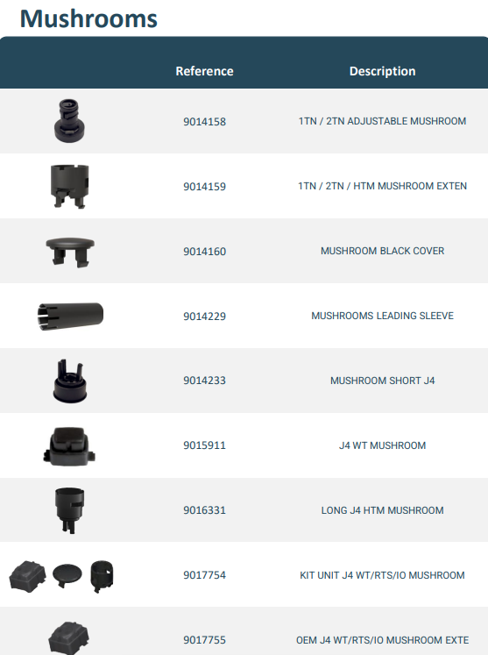
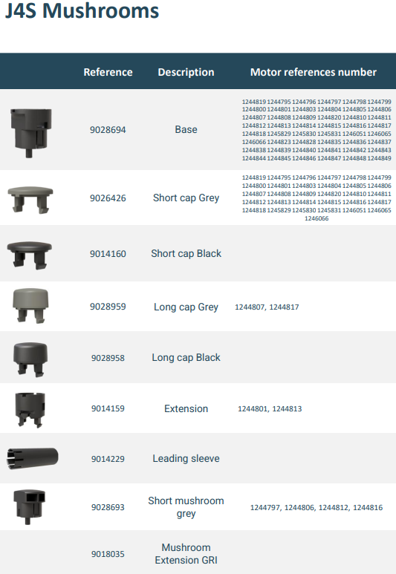
J4 io protect phase out – matrix – ACCESSORIES

