Slide 1
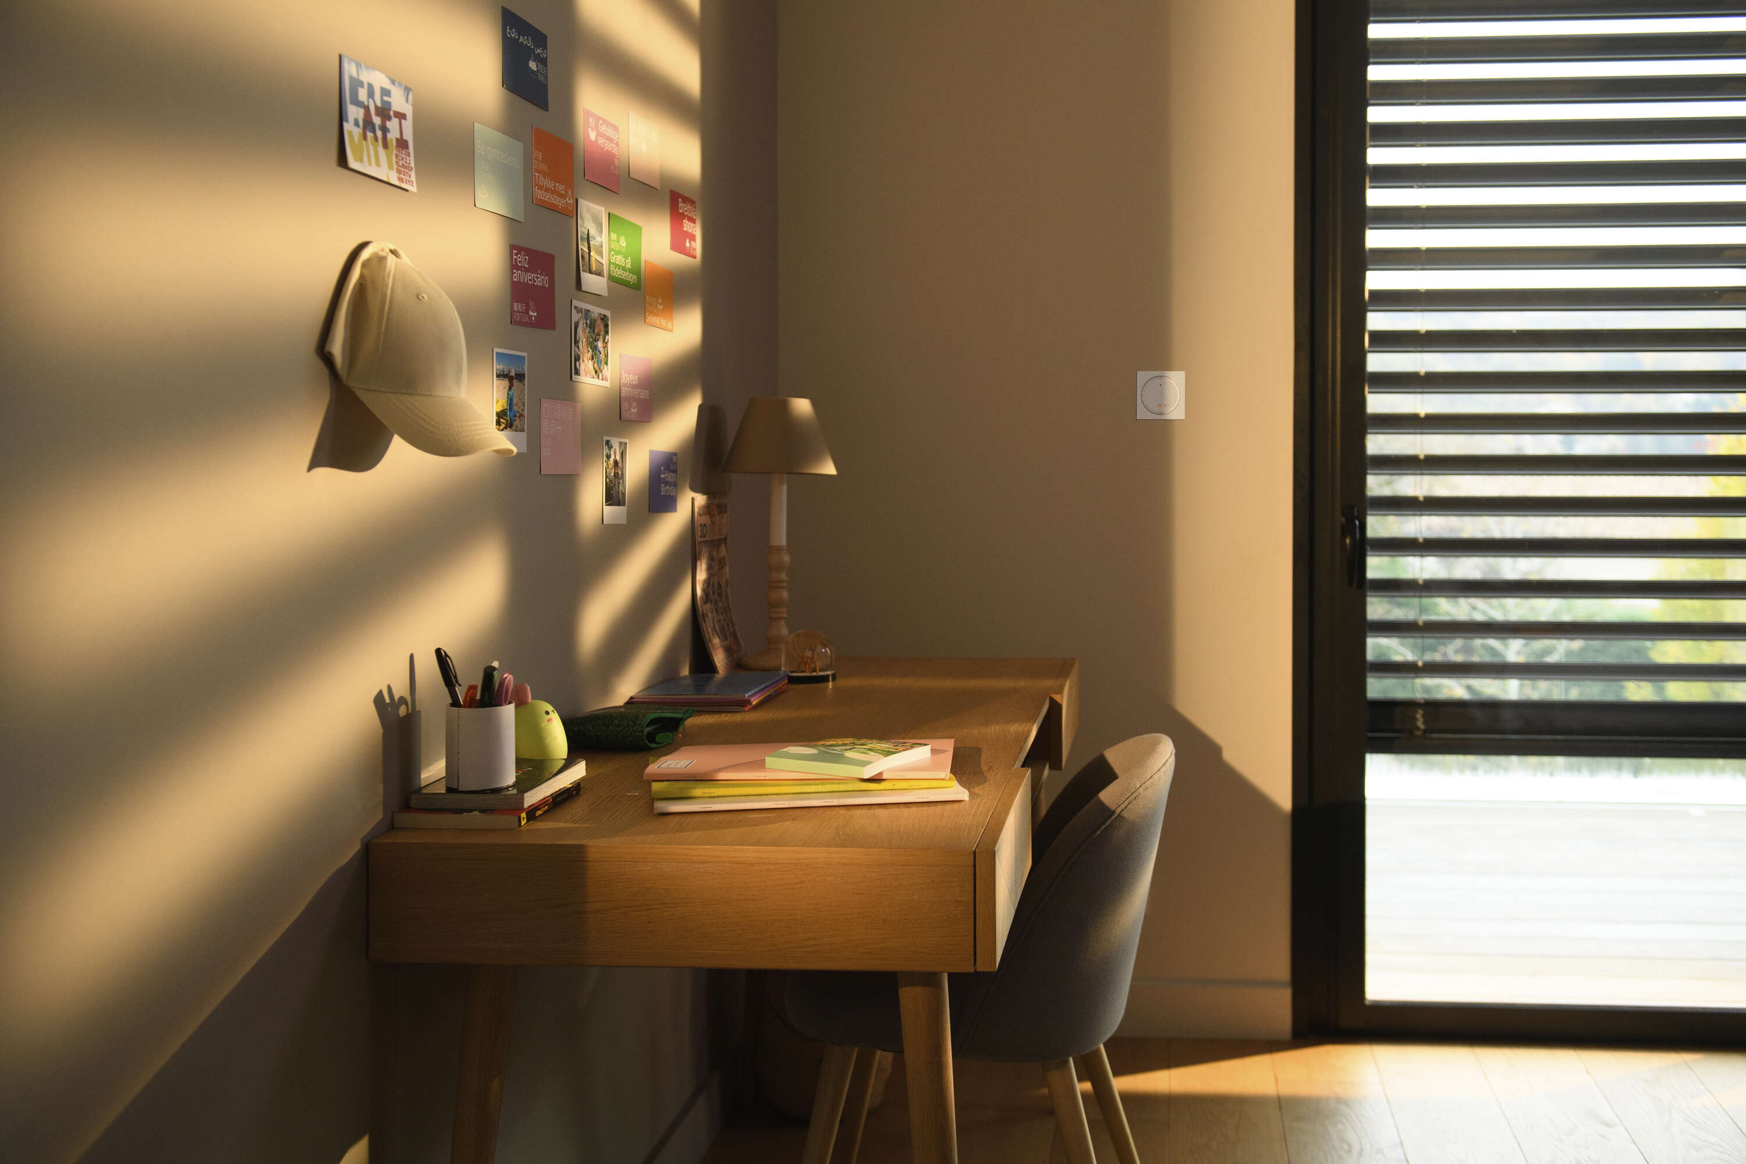
RS100 solar long life battery

Slide 2
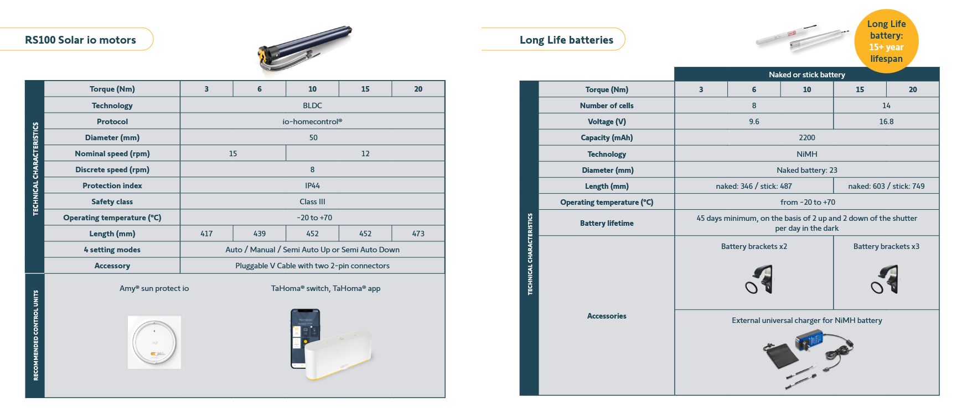

Slide 3
Replacements
OLD REF | OLD DESC | NEW REF | NEW DESC
9028192 | 9.6V NIMH NAKED BATTERY INTERNATIONAL UN | 9029727 | 9.6V NIMH NAKED BATTERY LL INT
9028194 | 9.6V NIMH BATTERY STICK INTL U | 9029729 | 9.6V NIMH BATTERY STICK LL INT
9028195 | 9.6V NIMH NAKED BATTERY INTL | 9029728 | 9.6V NIMH NAKED BATTERY LL INT
9028197 | 9.6V NIMH BATTERY STICK INTL | 9029730 | 9.6V NIMH BATTERY STICK LL INT
9028203 | 16.8V NIMH NAKED BATTERY INTERNATIONAL P | 9029732 | 16.8V NIMH NAKED BATTERY LL IN
9028200 | 16.8V NIMH NAKED BATTERY INTERNATIONAL U | 9029731 | 16.8V NIMH NAKED BATTERY LL IN
9028202 | 16.8V NIMH STICK BATTERY INTERNATIONL WITH ALUMINIUM COVER UNIT | 9029733 | 16.8V NIMH BATTERY STICK LL IN

