Slide 1

Situo II io & RTS range simplification

Slide 2
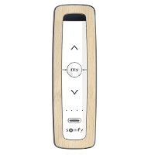
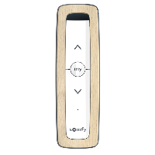
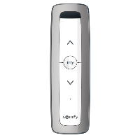
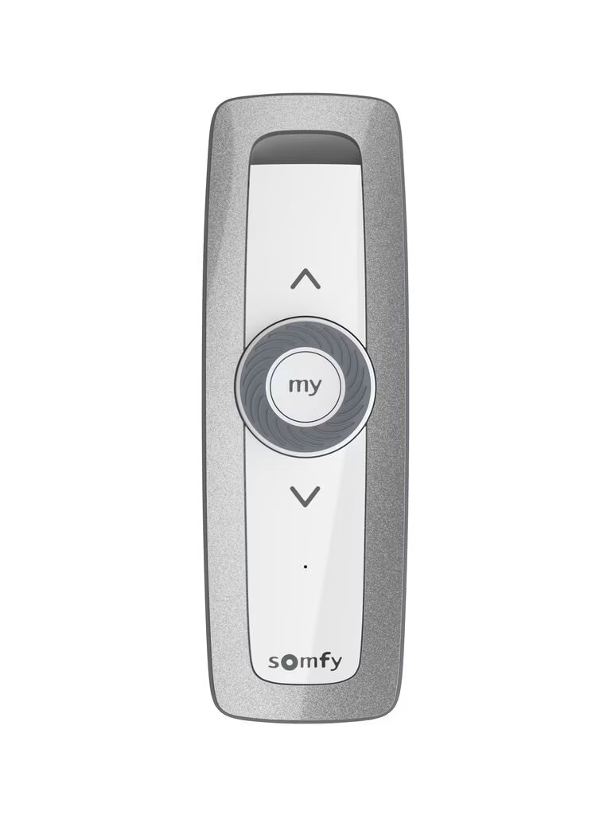
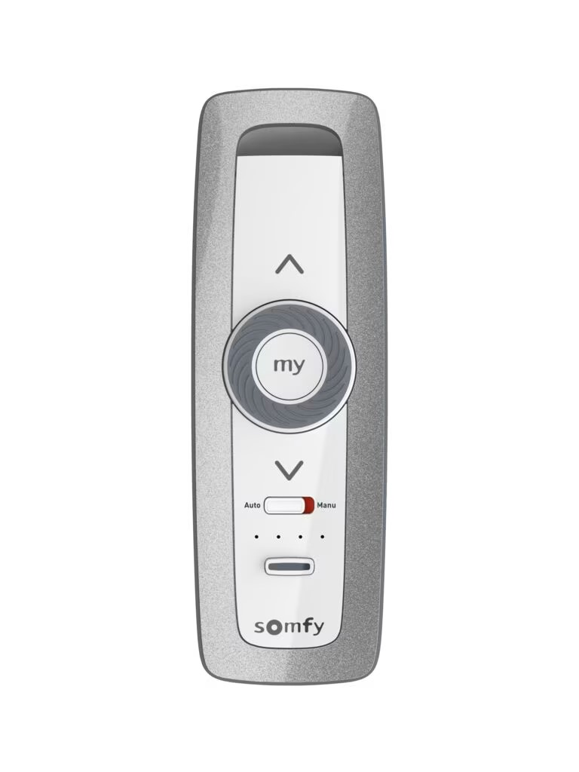
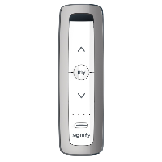
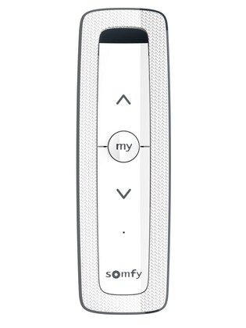
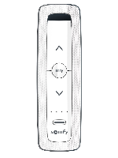
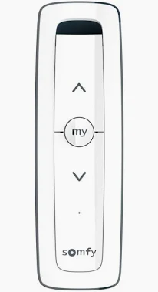
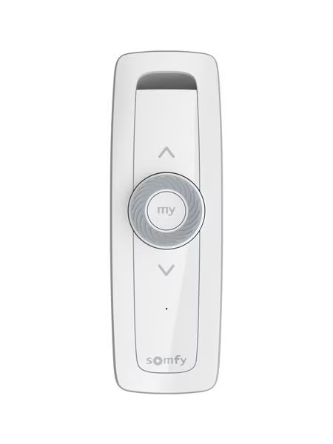
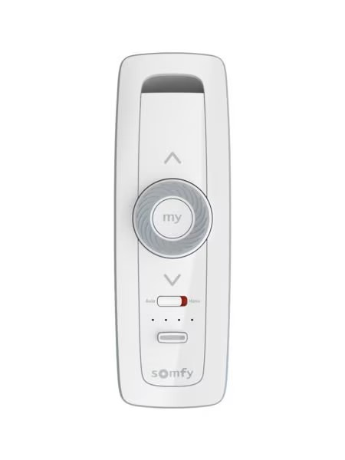
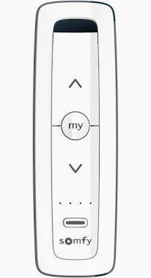
Situo II io & RTS coloured versions phase out
Situo II io & RTS phased out
Natural colour
Iron colour
Arctic colour
Situo II io & RTS remaining
Pure
The various color options for the Situo II series are not in demand on the market. All color options for all versions of the controller together represent 1% of orders. We have therefore decided to simplify our range.

Slide 3
Situo II io & RTS coloured versions substitution matrix
Phased out |  | Substitution
1870320 | SITUO 1 io Natural II | 1870312 | SITUO 1 io Pure II
1870316 | SITUO 1 io Iron II
1870324 | SITUO 1 io Arctic II
1870336 | SITUO 5 io Natural II | 1870328 | SITUO 5 io Pure II
1870642 | SITUO 5 IO NATURAL II DIY
1870332 | SITUO 5 io Iron II
1870340 | Situo 5 io Arctic II
1870366 | SITUO 1 Variation io Iron II | 1870363 | SITUO 1 Variation io Pure II
1870373 | SITUO 5 Variation A/M io Iron II | 1870369 | SITUO 5 Variation A/M io Pure II
1870407 | Situo 1 RTS Iron II | 1870403 1870435 | Situo 1 RTS Pure II Situo 1 Soliris RTS Pure II
1870411 | Situo 1 RTS Natural II
1870415 | Situo 1 RST Arctic II
1870423 | Situo 5 RTS Iron II | 1870419 1870438 | Situo 5 RTS Pure II Situo 5 Soliris RTS Pure II
1870427 | Situo 5 RTS Natural II
1870431 | Situo 5 RTS Arctic II
1811609 | Situo 1 Var RTS Iron II | 1811608 | Situo 1 Var RTS Pure II
1811611 | Situo 5 Var RTS Iron II | 1811610 | Situo 5 Var RTS Pure II

