Slide 1

Smoove RTS range replacement

Slide 2
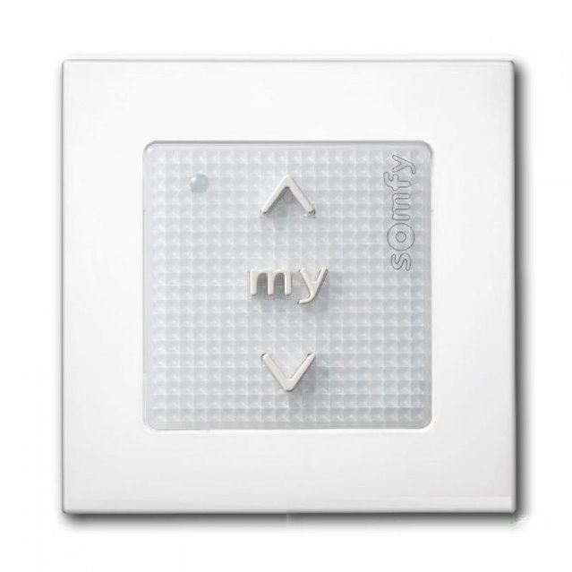
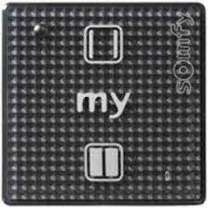
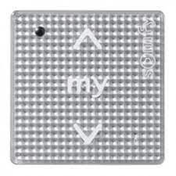
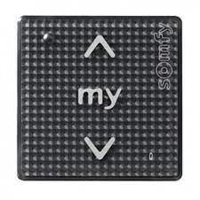
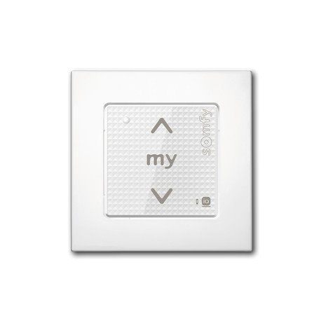
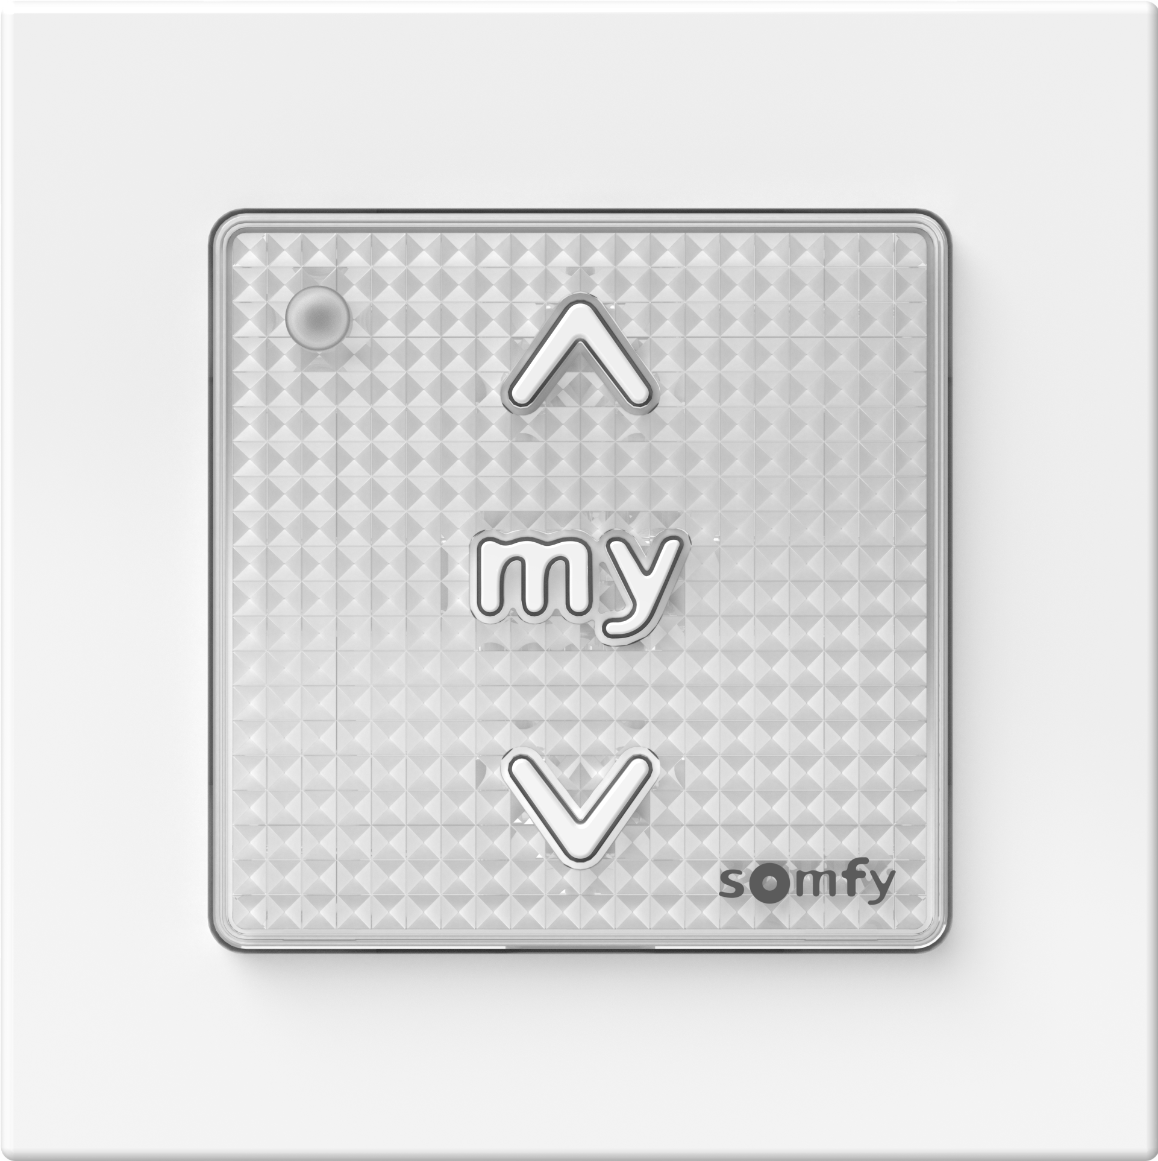
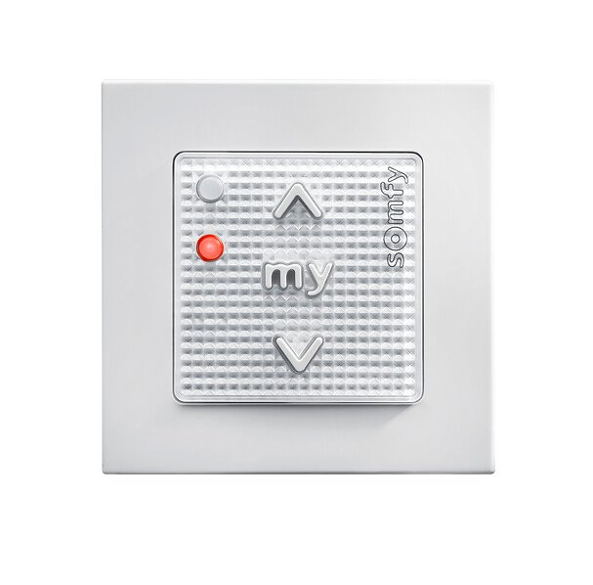
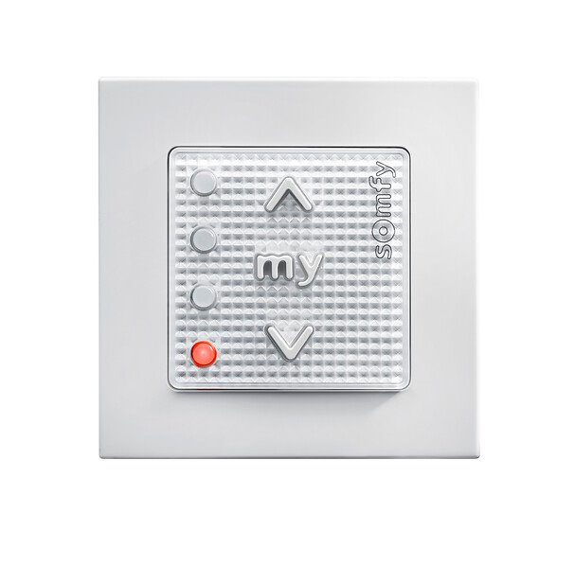
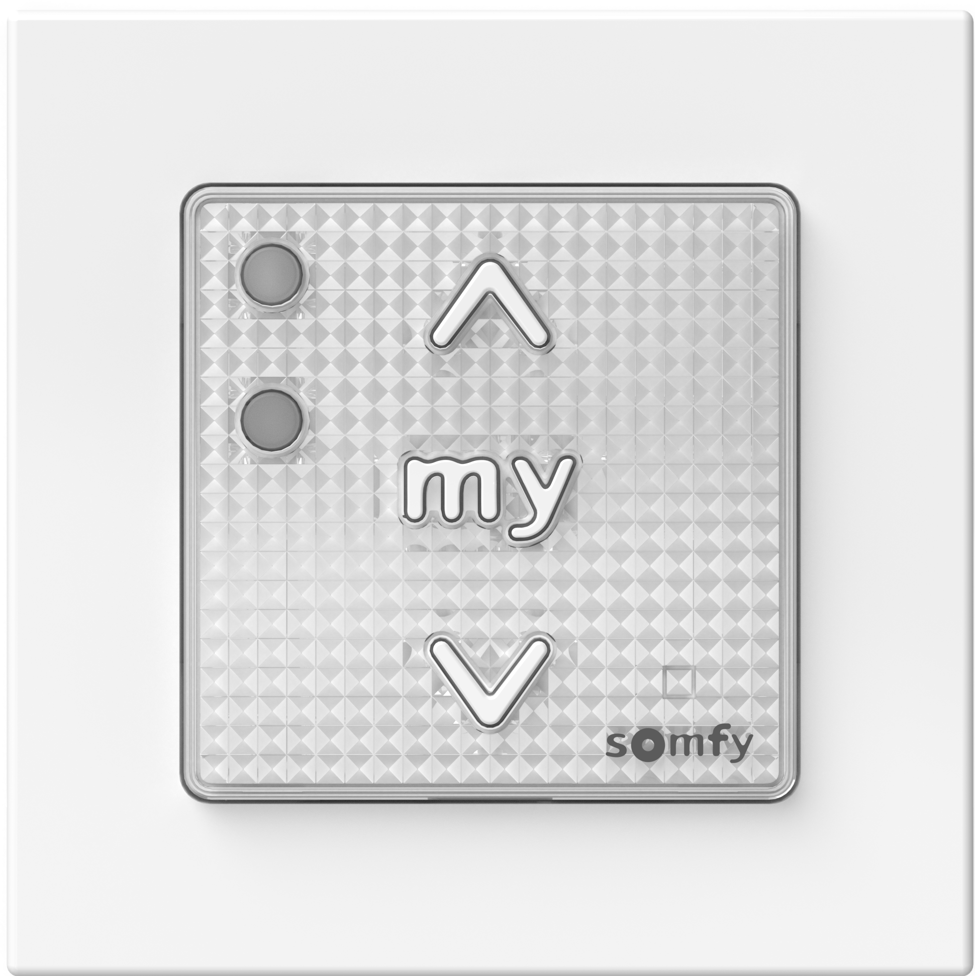
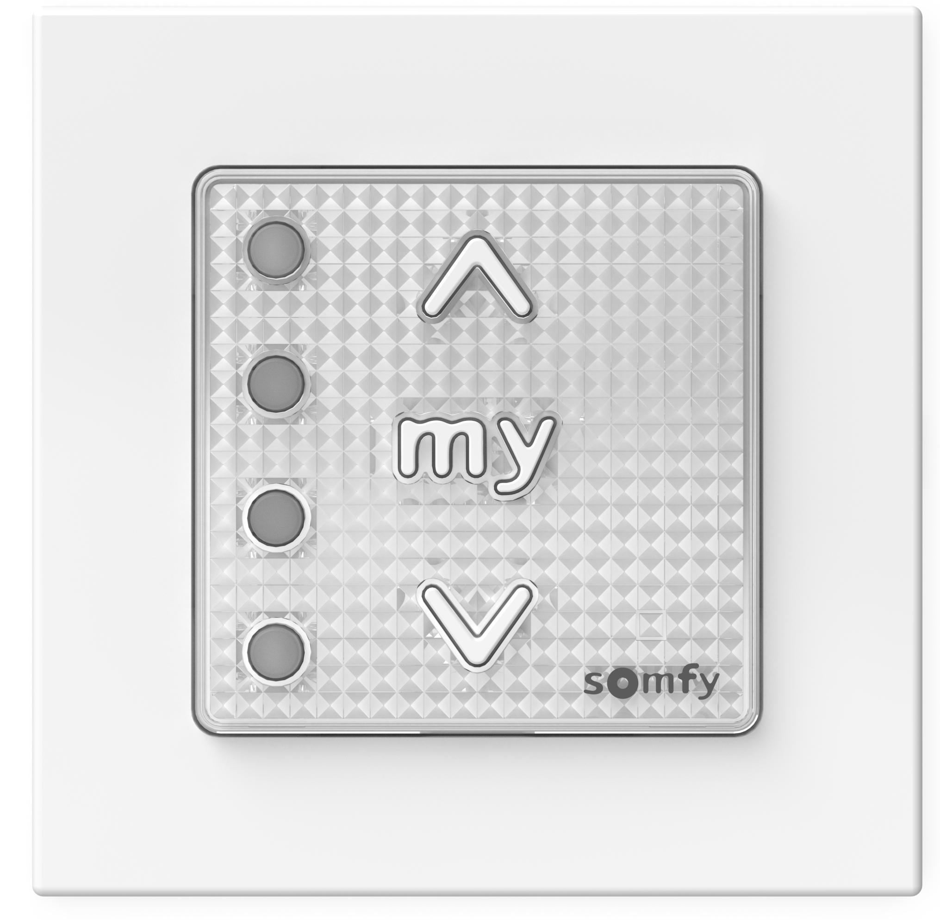
Smoove RTS range replacement in 2025
Smoove RTS
Smoove Origin RTS
Smoove 1 Open/Close RTS Black / Pure shine
Smoove 1 RTS Silver shine
Smoove 1 RTS Black shine
Smoove 1 RTS Pure Shine
Smoove II RTS
Smoove 1 RTS II
Smoove RTS
The Smoove RTS II range offers a complete redesigned range. With its standard compliant design (access to battery cell) and the rationalization (only mechanical switches), the Smoove iconic wall switch range remains up to date to keeps enabling / piloting Somfy solar protections.
Technical datesheets and manuals
Smoove Origin RTS
Smoove Origin RTS
Smoove II RTS
Smoove 2 RTS II
Smoove 4 RTS II

Slide 3
Smoove RTS range replacement in 2025
1811546 | SMOOVE ORIGIN RTS PURE PACK 84 | 1871352 | SMOOVE 1 RTS II + FR A PACK
1810880 | SMOOVE ORIGIN RTS + FRAME | 1871355 | SMOOVE 1 RTS II + FR B
1811045 | SMOOVE ORIGIN INTL RTS + FRAME
1810881 | SMOOVE 1 RTS PURE SHINE
1810882 | SMOOVE 1 RTS BLACK SHINE
1810883 | SMOOVE 1 RTS SILVER SHINE
1811011 | SMOOVE 1 RTS PURE SHINE O/C
1811009 | SMOOVE 1 RTS BLACK SHINE O/C
1800223 | SMOOVE ORIGIN 2 RTS + FRAME | 1871366 | SMOOVE 2 RTS II + FR B
1800295 | SMOOVE ORIGIN 4 RTS + FRAME | 1871375 | SMOOVE 4 RTS II + FR B
Replacement already ongoing
Rest of references will be replaced during the year as stocks are depleted.

