Slide 1
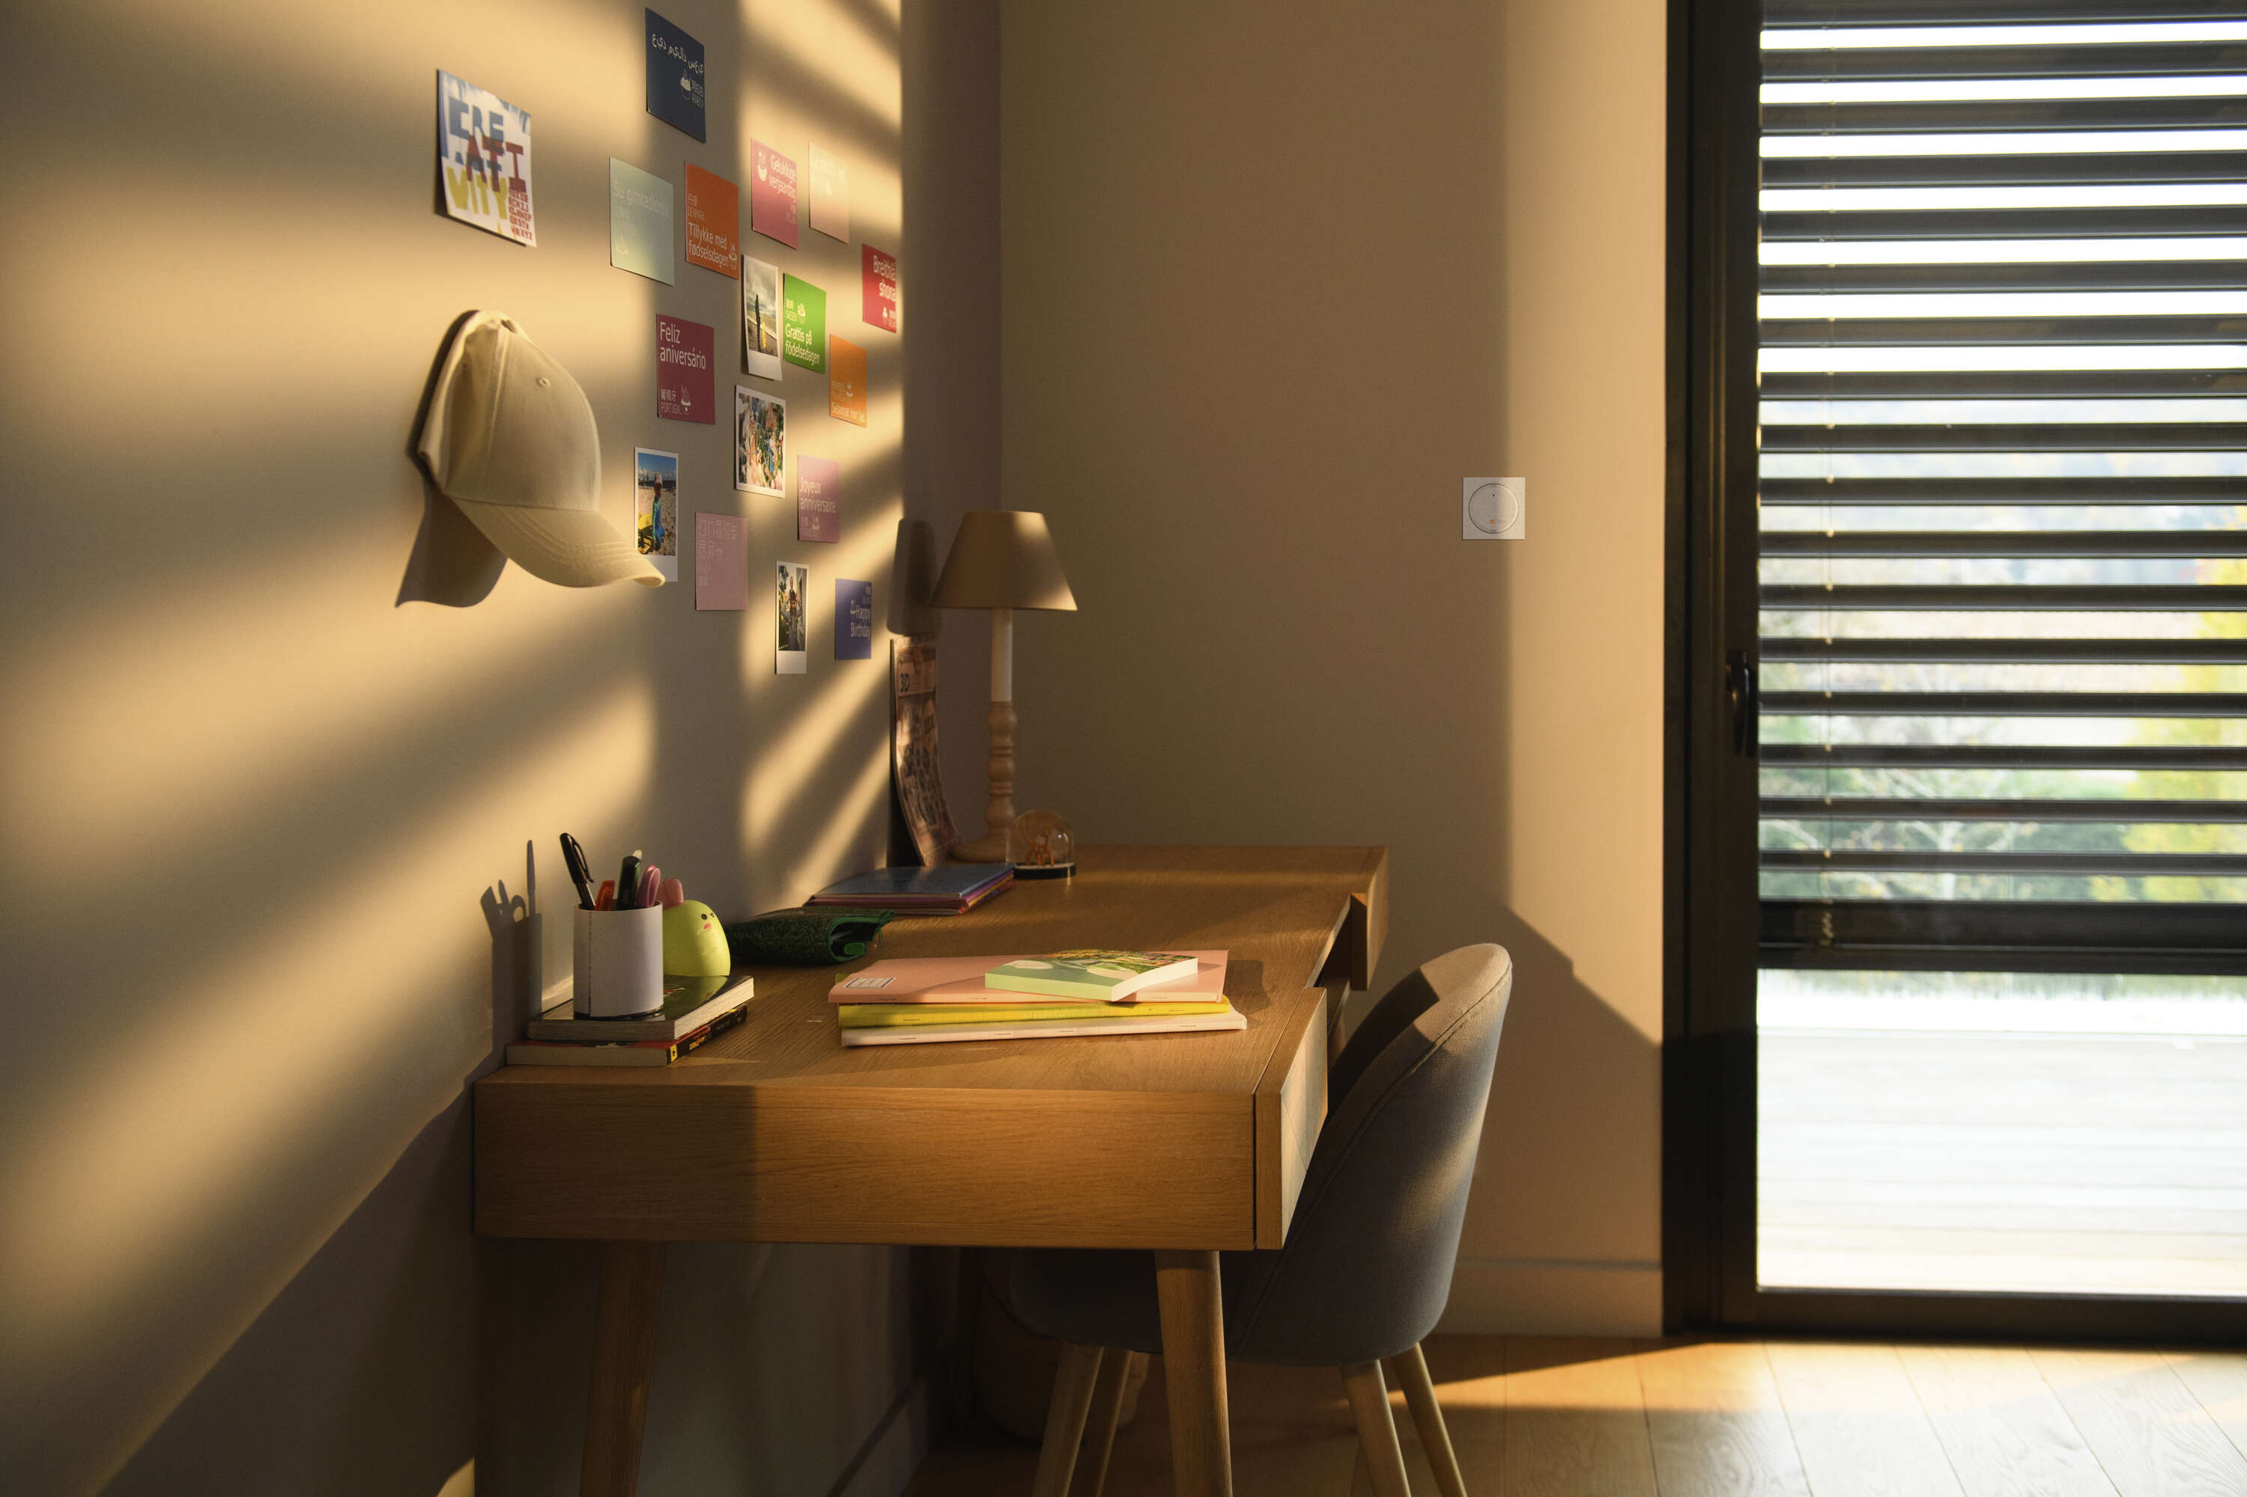
Smoove phase out information
Amy io range

Slide 2
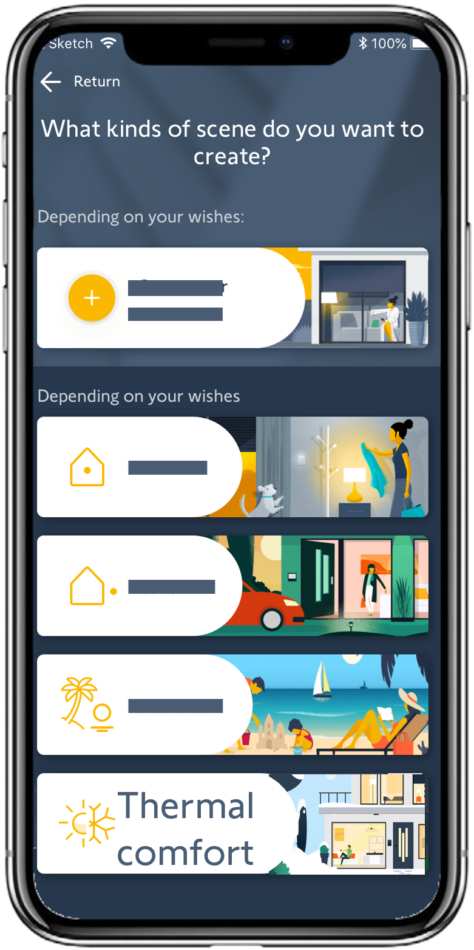
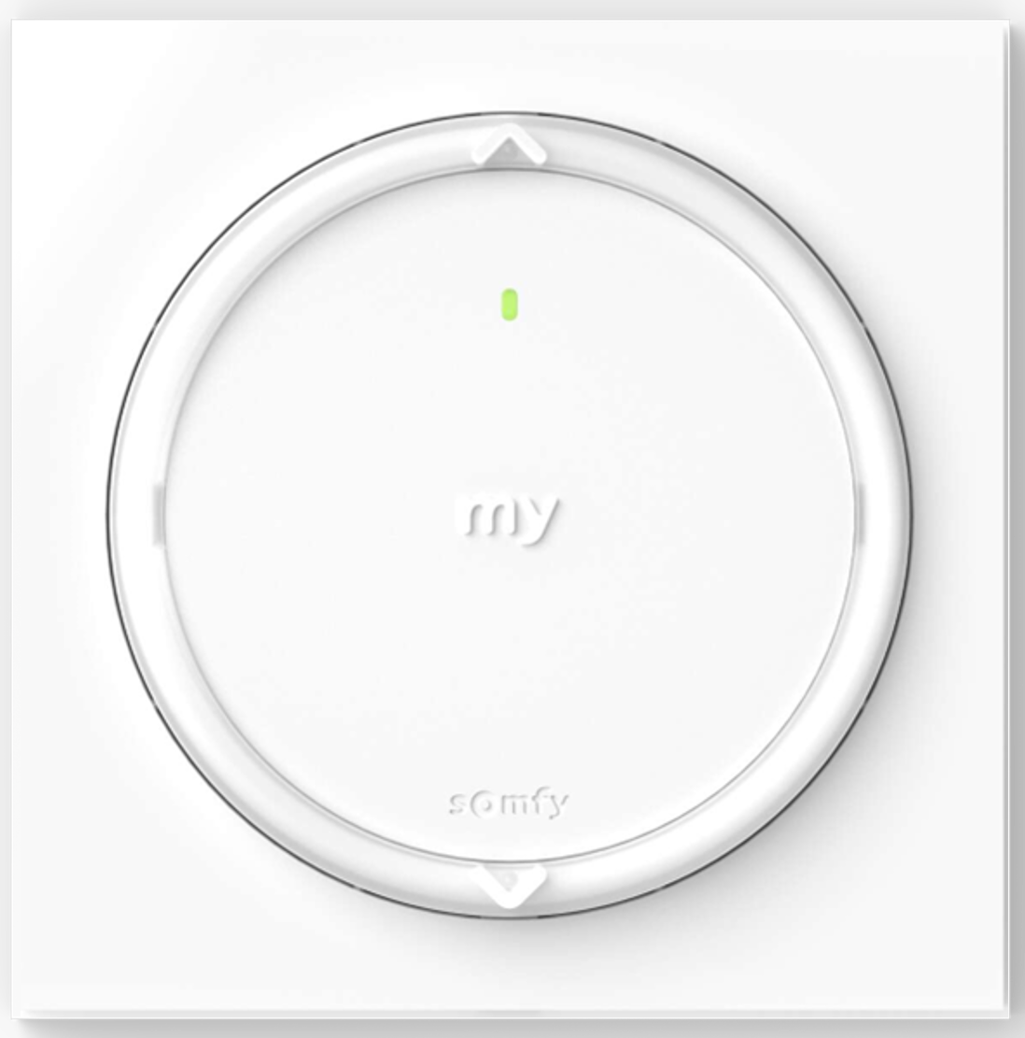
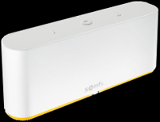

Main functions
Control sun protection and
use indoor temperature information
Amy io range (1 channel versions)
+
Notes:
Thanks to the Amy io range, improve your thermal comfort during heatwaves. It’s the first wall switches range with an embedded temperature sensor working in stand-alone thanks to an algorithm or connected with a TaHoma scene.
Let’s discover the Amy io range.

Slide 3
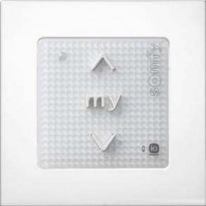
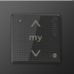
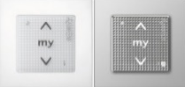
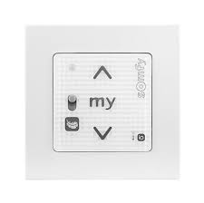
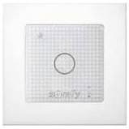
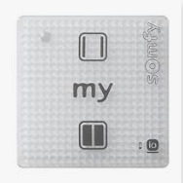

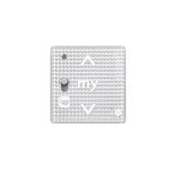
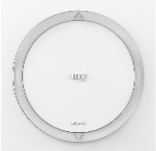
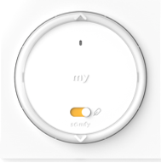
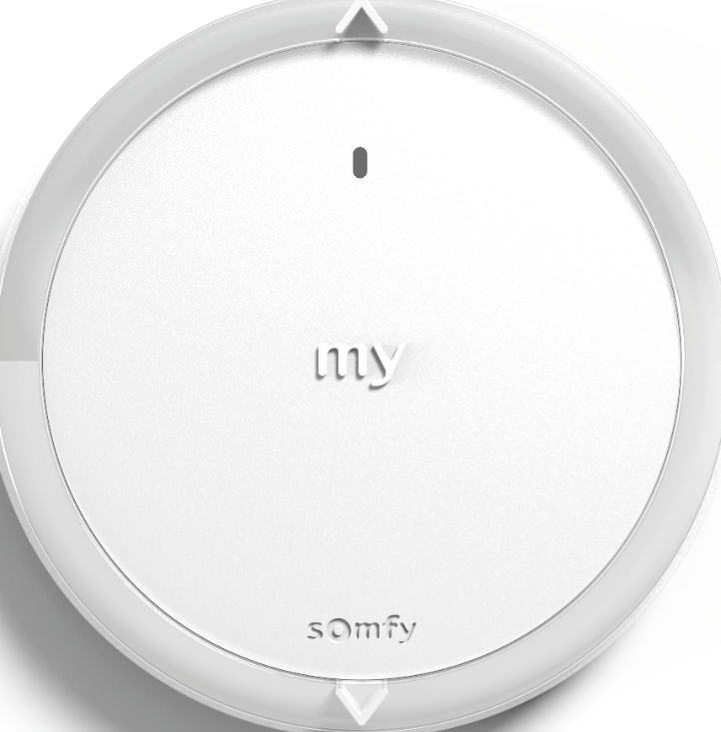

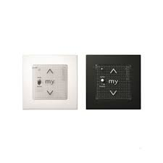
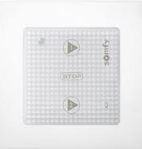

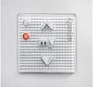

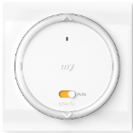

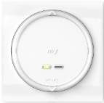
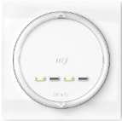
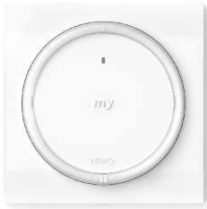
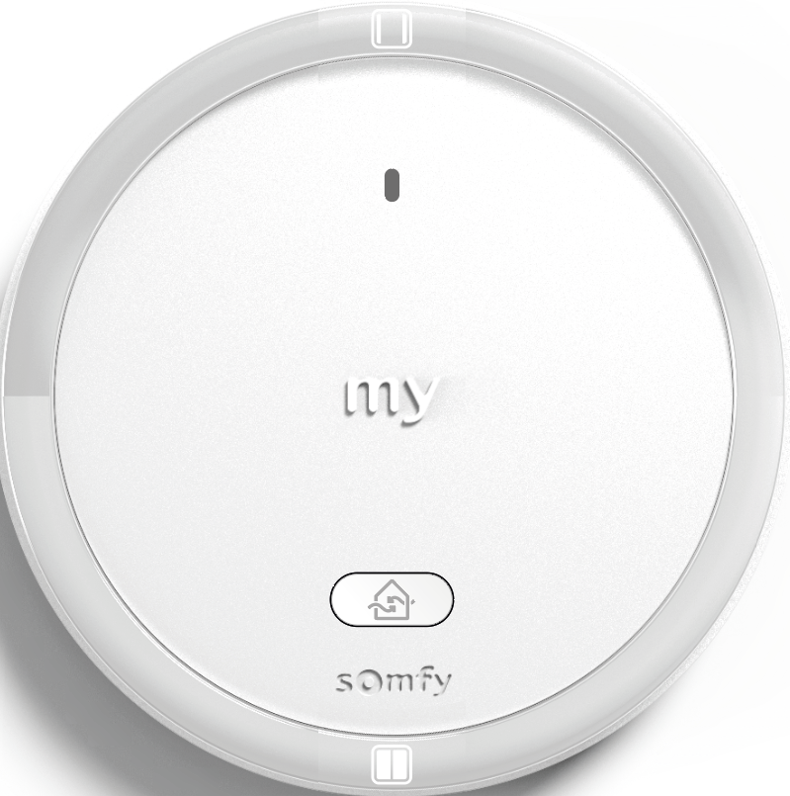
Comparison
Smoove
Smoove Sensitif io
Smoove Origin io
Smoove lighting io
Smoove O/C io
Smoove RS100 io
Amy
Amy 1 io
Amy 1 Modes io
Amy 1 RS100 io
Smoove
Smoove A/M io
Smoove Scene launcher
Smoove Window Air io
Smoove 2 channels io
Smoove 4 channels io
Amy
Amy 1 A/M Modes io
Amy Scene Player io
Amy 1 Window SL io
Amy 2 Modes io
Amy 4 Modes io
All Amy 1 channel io embeds an indoor temperature sensor working with TaHoma®

Slide 4
Replacements
Ref number | Long Designation ( MDM) | OLD ref | Smoove description
1871057 | Amy 1 Channel io B (RU RO SL CR EN PL CS HU) Pack 84 | 1811547 | SMOOVE ORIGIN IO PURE PACK 84
1871058 | Amy 1 Channel io + Frame B (RU RO SL CR EN PL CS HU) | 1811090 | SMOOVE 1 O/C IO BLACK SHINE
 |  | 1811066 | SMOOVE ORIGIN IO BLANC
 |  | 1811089 | SMOOVE 1 O/C IO PURE SHINE
 |  | 1822651 | SMOOVE LIGHTING IO
 |  | 1811093 | SMOOVE 1 IN IO PURE BRILLANT
1871065 | Amy Scene Player io B (RU RO SL CR EN PL CS HU) | 1824035 | SCENARIO PLAYER FOR TAHOMA
1871075 | Amy 1 Channel 1to4Modes io + Frame B (RU RO SL CR EN PL CS HU) | 1811003 | SMOOVE 1 IO BLANC
 |  | 1811005 | SMOOVE 1 IO NOIR
 |  | 1811007 | SMOOVE 1 IO ACIER
 |  | 1822651 | SMOOVE LIGHTING IO
1871084 | Amy 1 Channel Auto/Manu 1to4Modes io + Frame B (RU RO SL CR EN PL CS HU) | 1811013 | SMOOVE 1 A/M IO BLANC
 |  | 1811014 | SMOOVE 1 A/M IO ACIER
 |  | 1811015 | SMOOVE 1 A/M IO NOIR
1871105 | Amy 1 Channel RS100 io + Frame B (RU RO SL CR EN PL CS HU) | 1811321 | SMOOVE RS100 IO PURE SHINE +
 |  | 1811722 | SMOOVE ORIGIN RS100 IO + FRAME
 |  | 1811315 | SMOOVE RS100 IO PURE SHINE
 |  | 1811316 | SMOOVE RS100 IO BLACK SHINE
 |  | 1811317 | SMOOVE RS100 IO SILVER SHINE
1871094 | Amy 2 Channels 1to4Modes io + Frame B (RU RO SL CR EN PL CS HU) | 1800204 | SMOOVE ORIGIN 2 IO + FRAME
1871113 | Amy 4 Channels 1to4Modes io + Frame B (RU RO SL CR EN PL CS HU) | 1800205 | SMOOVE ORIGIN 4 IO + FRAME 12L

